Slide 1

Clustering Five Financial Hub of the World according to essential venues
-
Nishant Kumar

Slide 2
Business Problem:
Which cities are similar?
Which city ranks better in terms of essential venues?
What is the venue is omni present and tops the list?
Which city have more essential venues, both in terms of number and density?

Slide 3
Data Description:
City Latitude/ Longitude:
Data is obtained using opencage library by fetching in city name and country name
Website: https://opencagedata.com
City venues:
Data is obtained using Foursquare API
Website: https://foursquare.com
City, Country, Population:
Obtained from google
Website: https://google.com

Slide 4
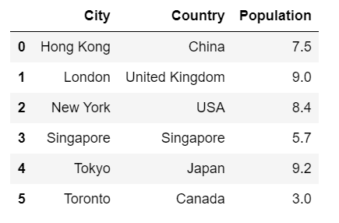
Available Dataset:

Slide 5
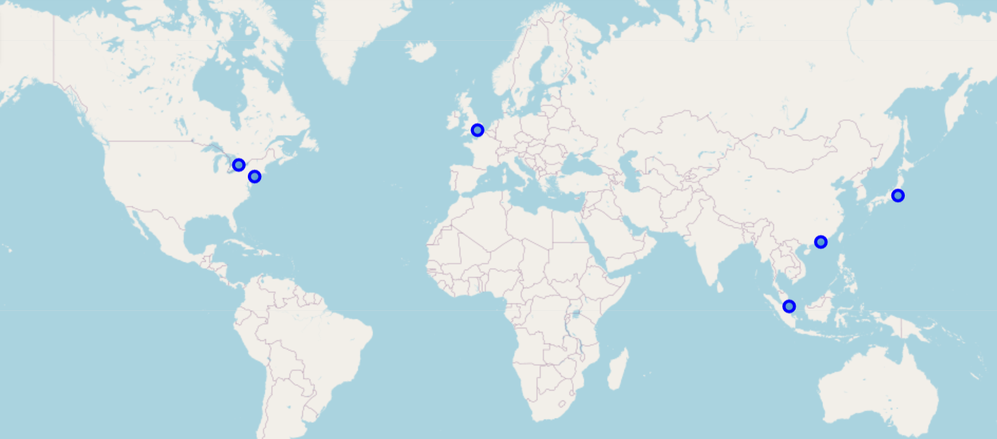
Geospatial image of Dataset

Slide 6
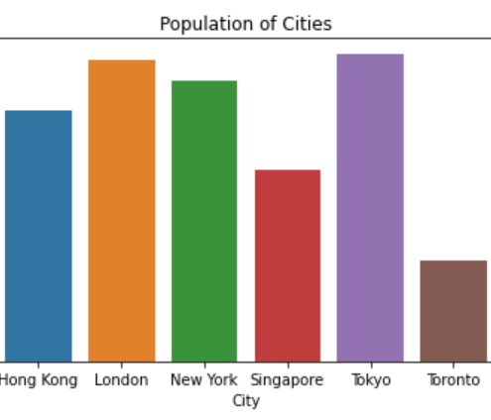
Observations:
Population of dataset

Slide 7
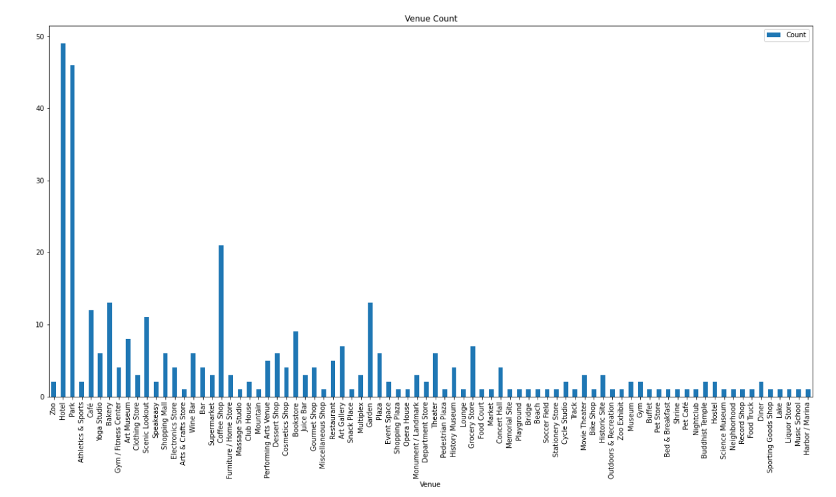
Venue Count

Slide 8
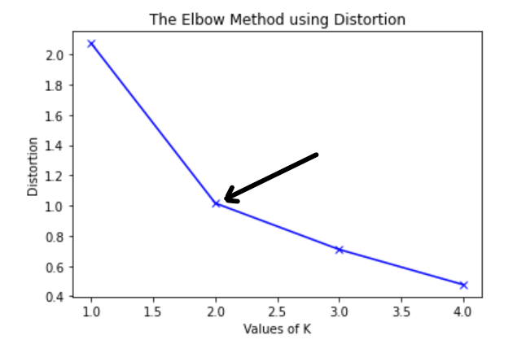
Optimized value of K

Slide 9
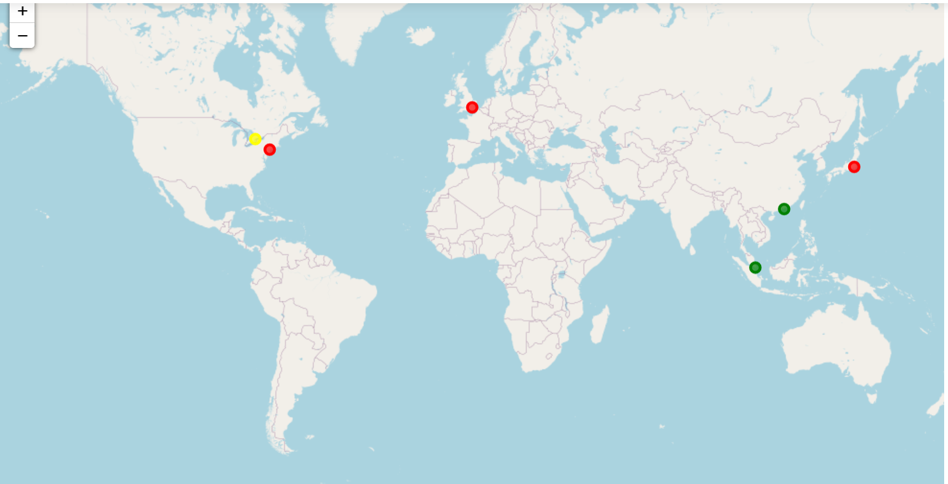
World map after clustering

Slide 10
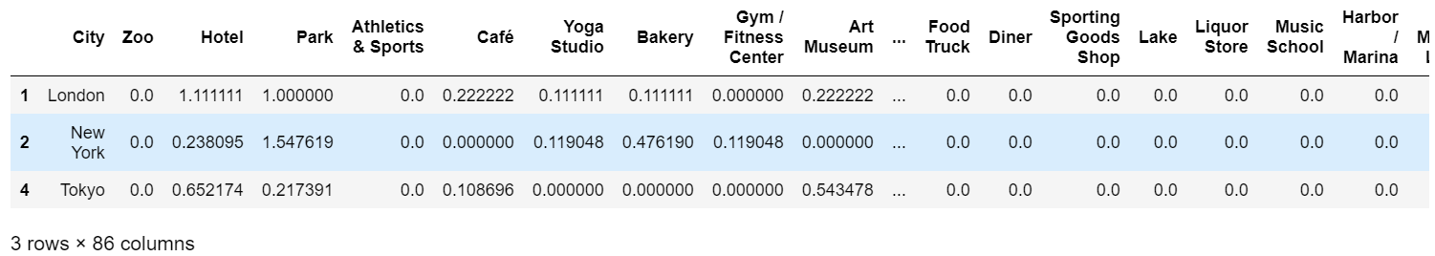
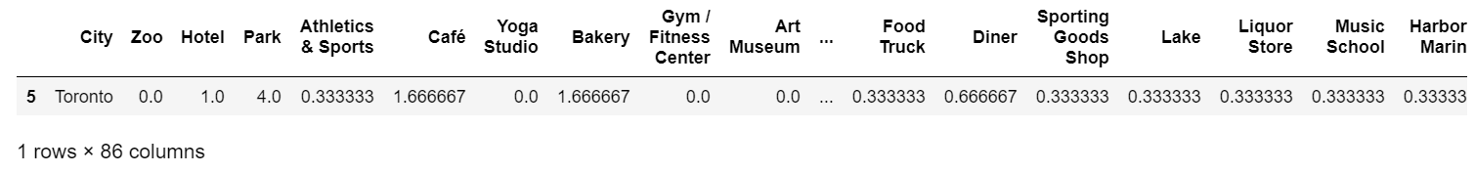
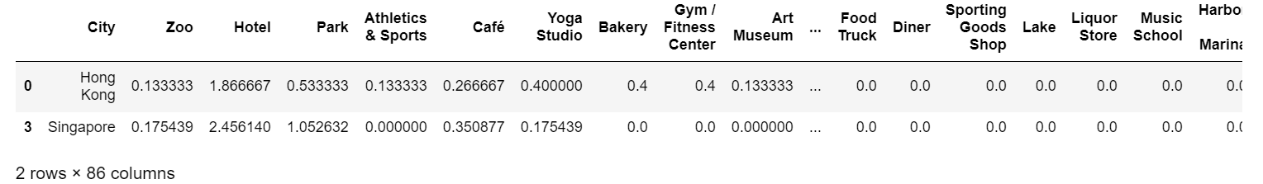
Cluster 0
Cluster 1
Cluster 2

Slide 11
Conclusion
It can be clearly concluded that cluster 1 which have low population and high density of essential services should be the choice for any individual planning to relocate. Hong Kong and Singapore have similar features and thus are clustered in cluster 2, while London, New York and Tokyo are clustered in to cluster 0.

Slide 12
Thankyou!
-Nishant Kumar

